Slide 1
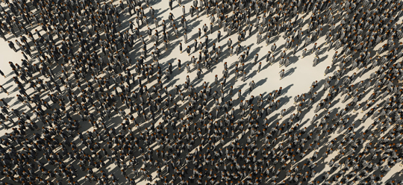
Inequality by Demographic Factors
Findings from Individual-Level Cantonal Tax Data
Oliver Hümbelin und Rudolf Farys

Slide 2
Introduction
Income inequality is often understood as a result of unequal wages which are moderated through redistribution. But how is income inequality related to demographic factors or demographic change?
Current Demographic Development in Europe: Older, more numerous and diverse (Demography report 2010)
In Switzerland the picture is similar:
In the last 30 year Population grew by 1.8 Mio (Source: STATPOP)
Swiss Population is ageing (Share of 65+: 1980: 14%, 2012: 17%, estimated in 2030: 24% Source: ESPOP, STATPOP, SCENARIO)
Household types are changing (Share of one-Person-HH 1980: 12%, 2012: 36%)
Notes:
Bevölkerung nach Alter
http://www.bfs.admin.ch/bfs/portal/de/index/themen/01/02/blank/key/alter/gesamt.html
Migration und Integration
http://www.bfs.admin.ch/bfs/portal/de/index/themen/01/07/blank/data/01.html
Haushaltsstrukturen und Familienformen
http://www.bfs.admin.ch/bfs/portal/de/index/themen/01/04/blank/01/02/01.html

Slide 3
Theories and «claims»
Demographic change and Inequality – Why does demography matter?
Ageing of a society and age groups
Ageing of the population leads to a conflict between generations (Kaufmann 2005), because the financial feasibility of social security is being tested. (see also Budowski & Nollert, M. (2010) > between group differences
Schellenbauer (2013): «In a world where wages depend only on the age of the workforce and are otherwise completely evenly, annual cross-section results leads to substantial inequality due to the age differences within society » > between group differences affects overall inequality
Notes:
Schellenbauer-These: Ungleichheit ist stark durch Alter determiniert

Slide 4
Theories and «claims»
Demographic change and Inequality – Why does demography matter?
Change of household structure and household types
In Social policy research between household differences are of interest (e.g. Fritschi & Bannwart 2013 for redistribution with family allowances) > between group differences
Change in the «way of people living together» affects inequality (people marry later, and divorce more often). Daly and Valetta (2006) think that part of the rise in inequality in the US is due to the rise of people living alone (or single parents). (See Peichl et al. 2011 for Germany) > between group differences affect overall inequality
Notes:
Weiterer Punkt: Between group differences are particularly interessting for Familienpolitischen Verteilungsfragen. Unterschiede zwischen verschiedenen Haushaltsformen> Unterschiede zwischen Haushalten mit und ohne Kinder. Aber auch bezüglich allgemeinen Verteilung von Ressourcen. Welche Haushaltsformen leben in prekären Verhältnissen?

Slide 5
Theory and Research Question
Demographic change and Inequality – Why does demography matter?
When liking demography to inequality, two inequality-relevant «processes» must be separated;
(1) Demographic change can affect overall distribution
(2) Demographic change and especially segregation can lead to higher between group differences (which doesn’t necessarily affect overall distribution).
Research Question: Is overall inequality affected by demographic change? Do between group differences change over time, when looking at age groups and household types?
Notes:
Weiterer Punkt: Between group differences are particularly interessting for Familienpolitischen Verteilungsfragen. Es Unterschiede zwischen verschiedenen Haushaltsformen> Unterschiede zwischen Haushalten mit und ohne Kinder.
Üblicherweise wird Einkommensungleichheit primär als Ausdruck von Lohnunterschieden verstanden.

Slide 6
Data
Statistical «case studies» with individual cantonal Tax Data
-> SNF-Project (http://inequalities.ch/)
Basel-City
Urban canton
German speaking
Time Periode: 1991-2011
Net income (Reineinkommen)
«Household types» and age groups constructed out of characteristics from tax-dossiers
Notes:
Regionalporträts der Kantone
http://www.bfs.admin.ch/bfs/portal/de/index/regionen/kantone/ju/key.html
http://www.bfs.admin.ch/bfs/portal/de/index/regionen/kantone/bs/key.html
Tax data is administrative data, which means it’s a processgenerated, non-reactive datasource (Diekman 2009:653)
Nice, because data coverage is good (no sample bias)
Bad, because data doesn’t necessairly fit the ideas of reaserach purpose. Tax Units are necessairly housholds > in generall we overestimate people living «alone»
Bei der Auswahl der Kantone haben wir zum Ziel möglichst lange Entwicklungsperioden abzudecken und gleichzeitig eine gewisse Variation bei relevanten Drittvariablen zu haben (Urbanitätsgrad, Kultur)

Slide 7
Variables
Household types and age groups
Household structure
Married without kids
Married with kids
Single mom
Single dad
Single man
Single woman
Age groups
-25, 26-65, >65
>Altersquotient abgebildet
Agegroups detailierter wegen Schellenbauer Claim, dass Einkommen stark durch Alter determiniert ist

Slide 8

Method
Decomposing Overall inequality into within and between group components (Hao & Naiman 2010)
Theil-Index, a inequality measure developed from information theory, is additively decomposable (Gini is not). Theil can be expressed as the between-group inequality plus the weighted sum of the inequality within each group
I$I(y;θ\text{)}=\sum_{l=1}^{L}{∅^{l}{\left(\frac{μ^{l}}{μ}\right)}^{θ}I\left(y^{l};θ\right)+I(μ^{1},…,μ^{l},…μ^{L};}θ$)
By decomposing the Theil-Index we partitioned the total income inequality into between-group inequality (e.g. between age groups and household types) and within-group inequality. Hence we see, how the differences between and within each group contribute to overall inequality
within
between
Notes:
Remarks - you get between group inequality by assigning the group mean to every group member and the calculate the inequaltiy meassure
- The within group inequality indices are weighted with the adjusted group proportion > with large groups the weights seem to sum to 1. Adjustment is important for small sample size

Slide 9
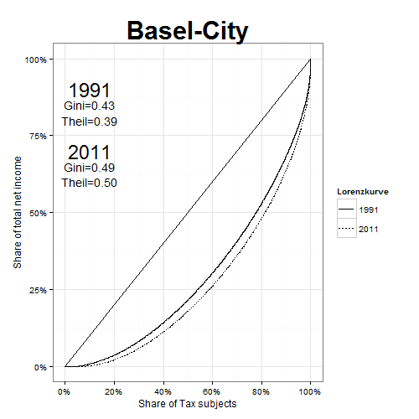
Results
Overall Inequality over time

Slide 10
Results
Age groups - Demographic change and contribution of within and between inequality to overall inequality
No big changes concerning shares of age groups
Within group inequality «drives» overall inequality…
…but importance of between group differences grew.

Slide 11
Results
Age groups - Between and within inequality
On average Youngsters lost, while retired gained and workforce were “stable”
But: Inequality within workforce and especially among youngsters increased drastically

Slide 12
Results
age groups - Contribution of each within inequality component and between inequality to overall inequality- age groups
Inequality among Workforce (26-65) contributes most to overall inequality (big group) and relevance of inequality within this age group is rising.
Small increase of between-group component is because Youngsters “lost” relatively

Slide 13
Results
Households - Demographic change and contribution of within and between inequality to overall inequality
Global trend reflects in cantonal data: decline of married and rise of single households
Between group differences contribute with a relevant share to overall inequality
Notes:
Muss man sich noch überlegen, wie das genau dargestellt werden soll

Slide 14
Results
Households- Between and within inequality
Between group differences are high between married and single
married HH gained more on average (pronunciation of between group differences)
But: Within-inequality rose especially among married with kids
Notes:
Muss man sich noch überlegen, wie das genau dargestellt werden soll

Slide 15
Results
Households- Contribution of each within inequality component and between inequality to overall inequality- age groups
Contribution to overall inequality is especially high du to inequality among married w. Kinds and within singles
Between group differences contribute also to overall inequality
Notes:
Muss man sich noch überlegen, wie das genau dargestellt werden soll

Slide 16
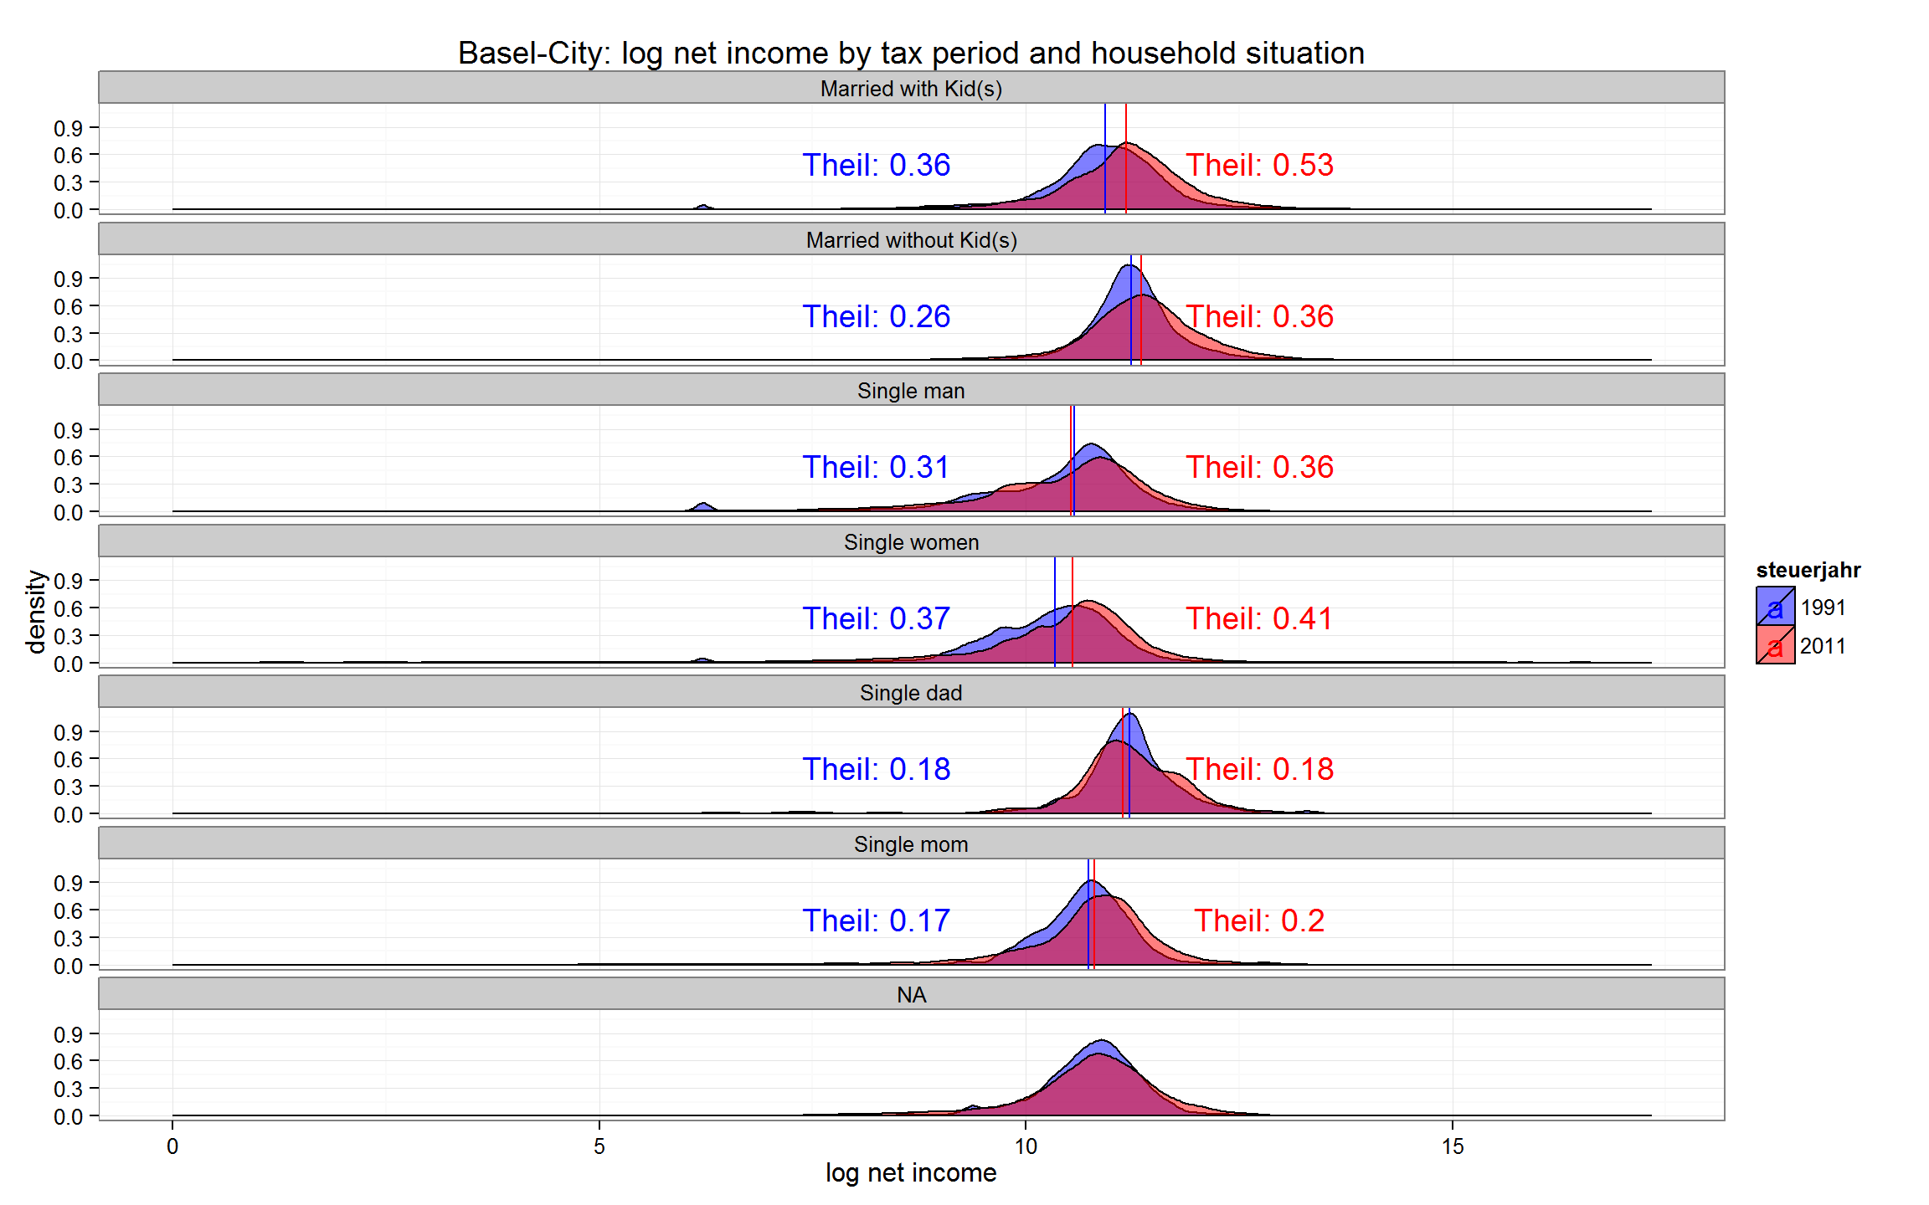
Results
Income distribution and inequality by household typs

Slide 17
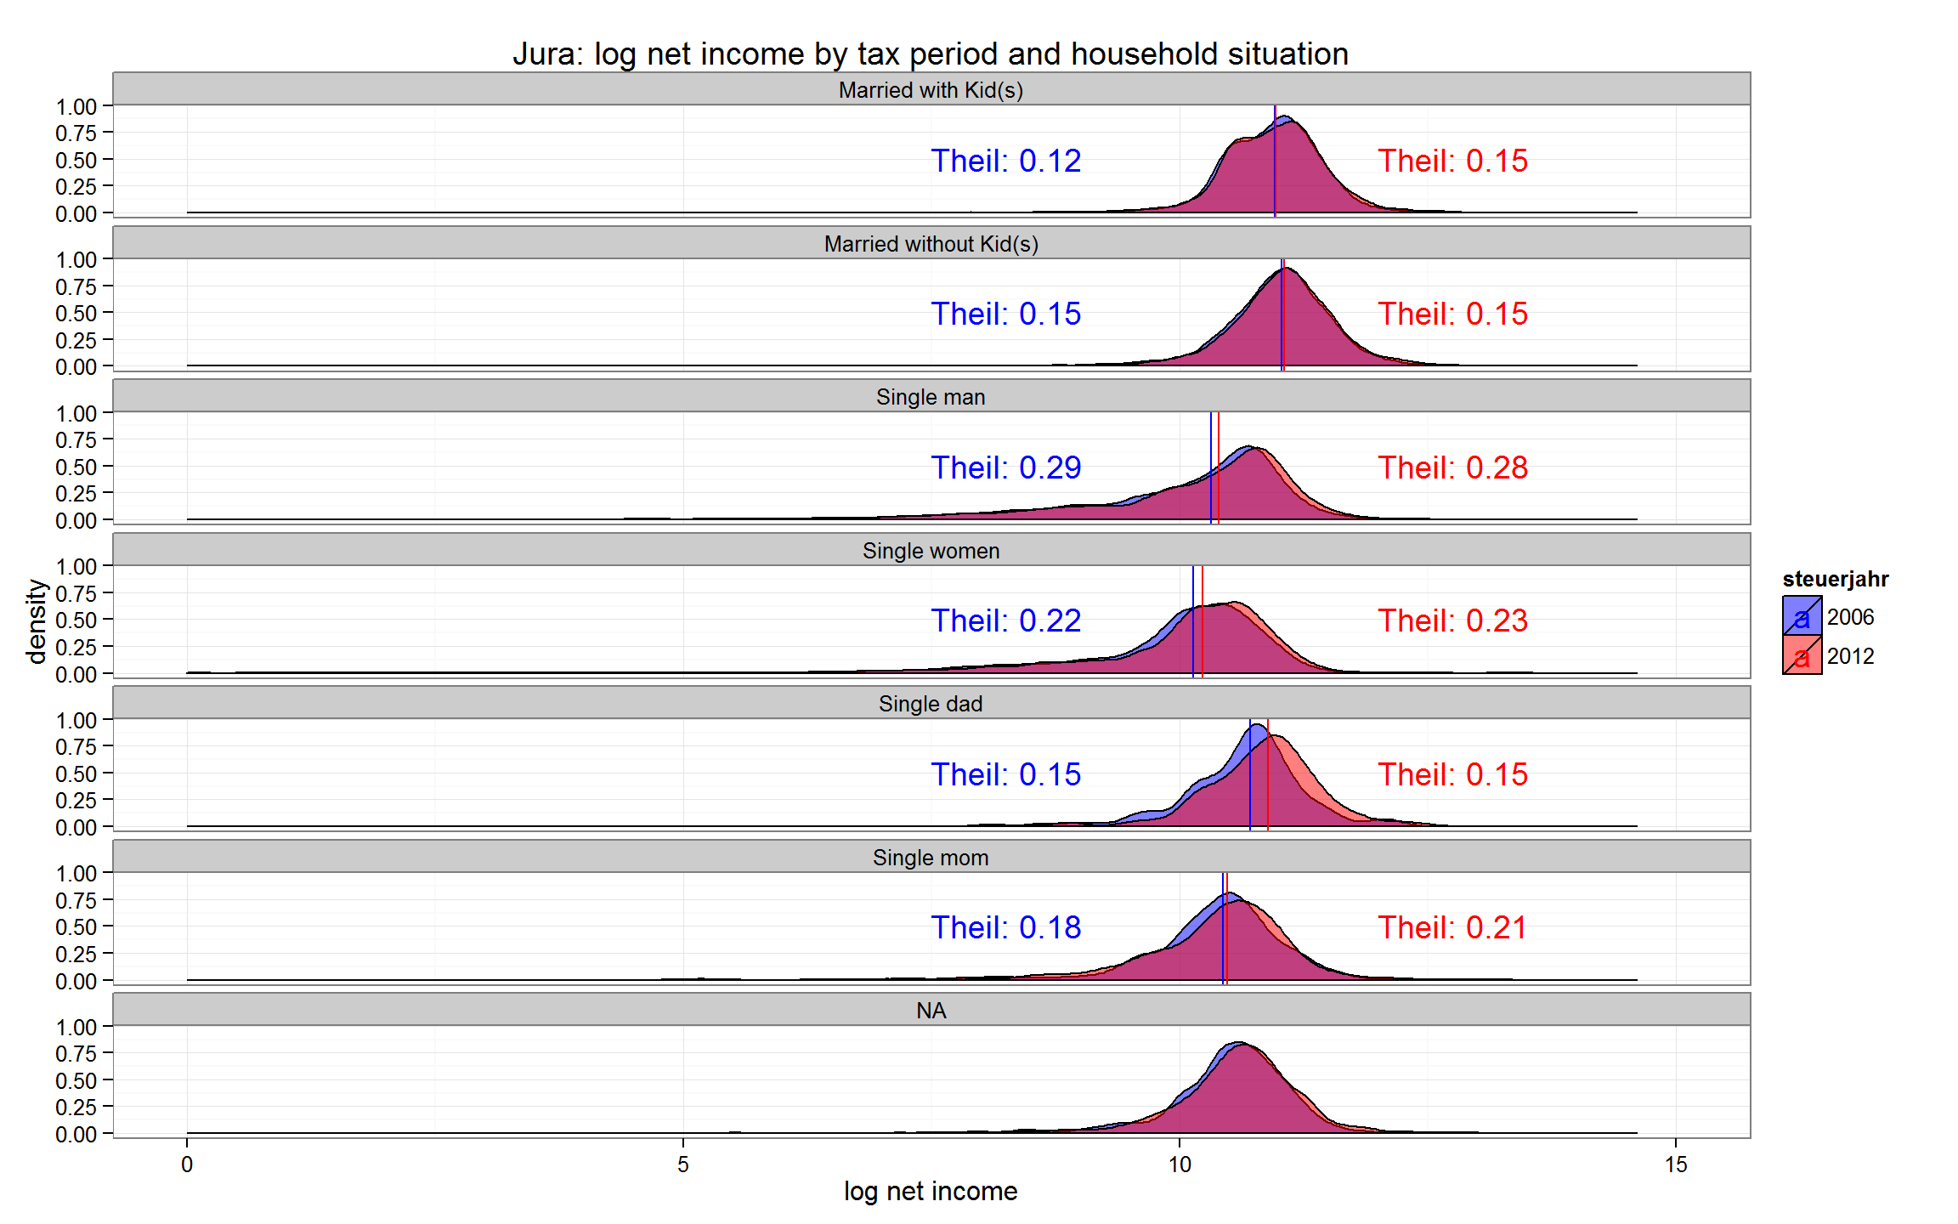
Results
Income distribution and inequality by household typs

Slide 18
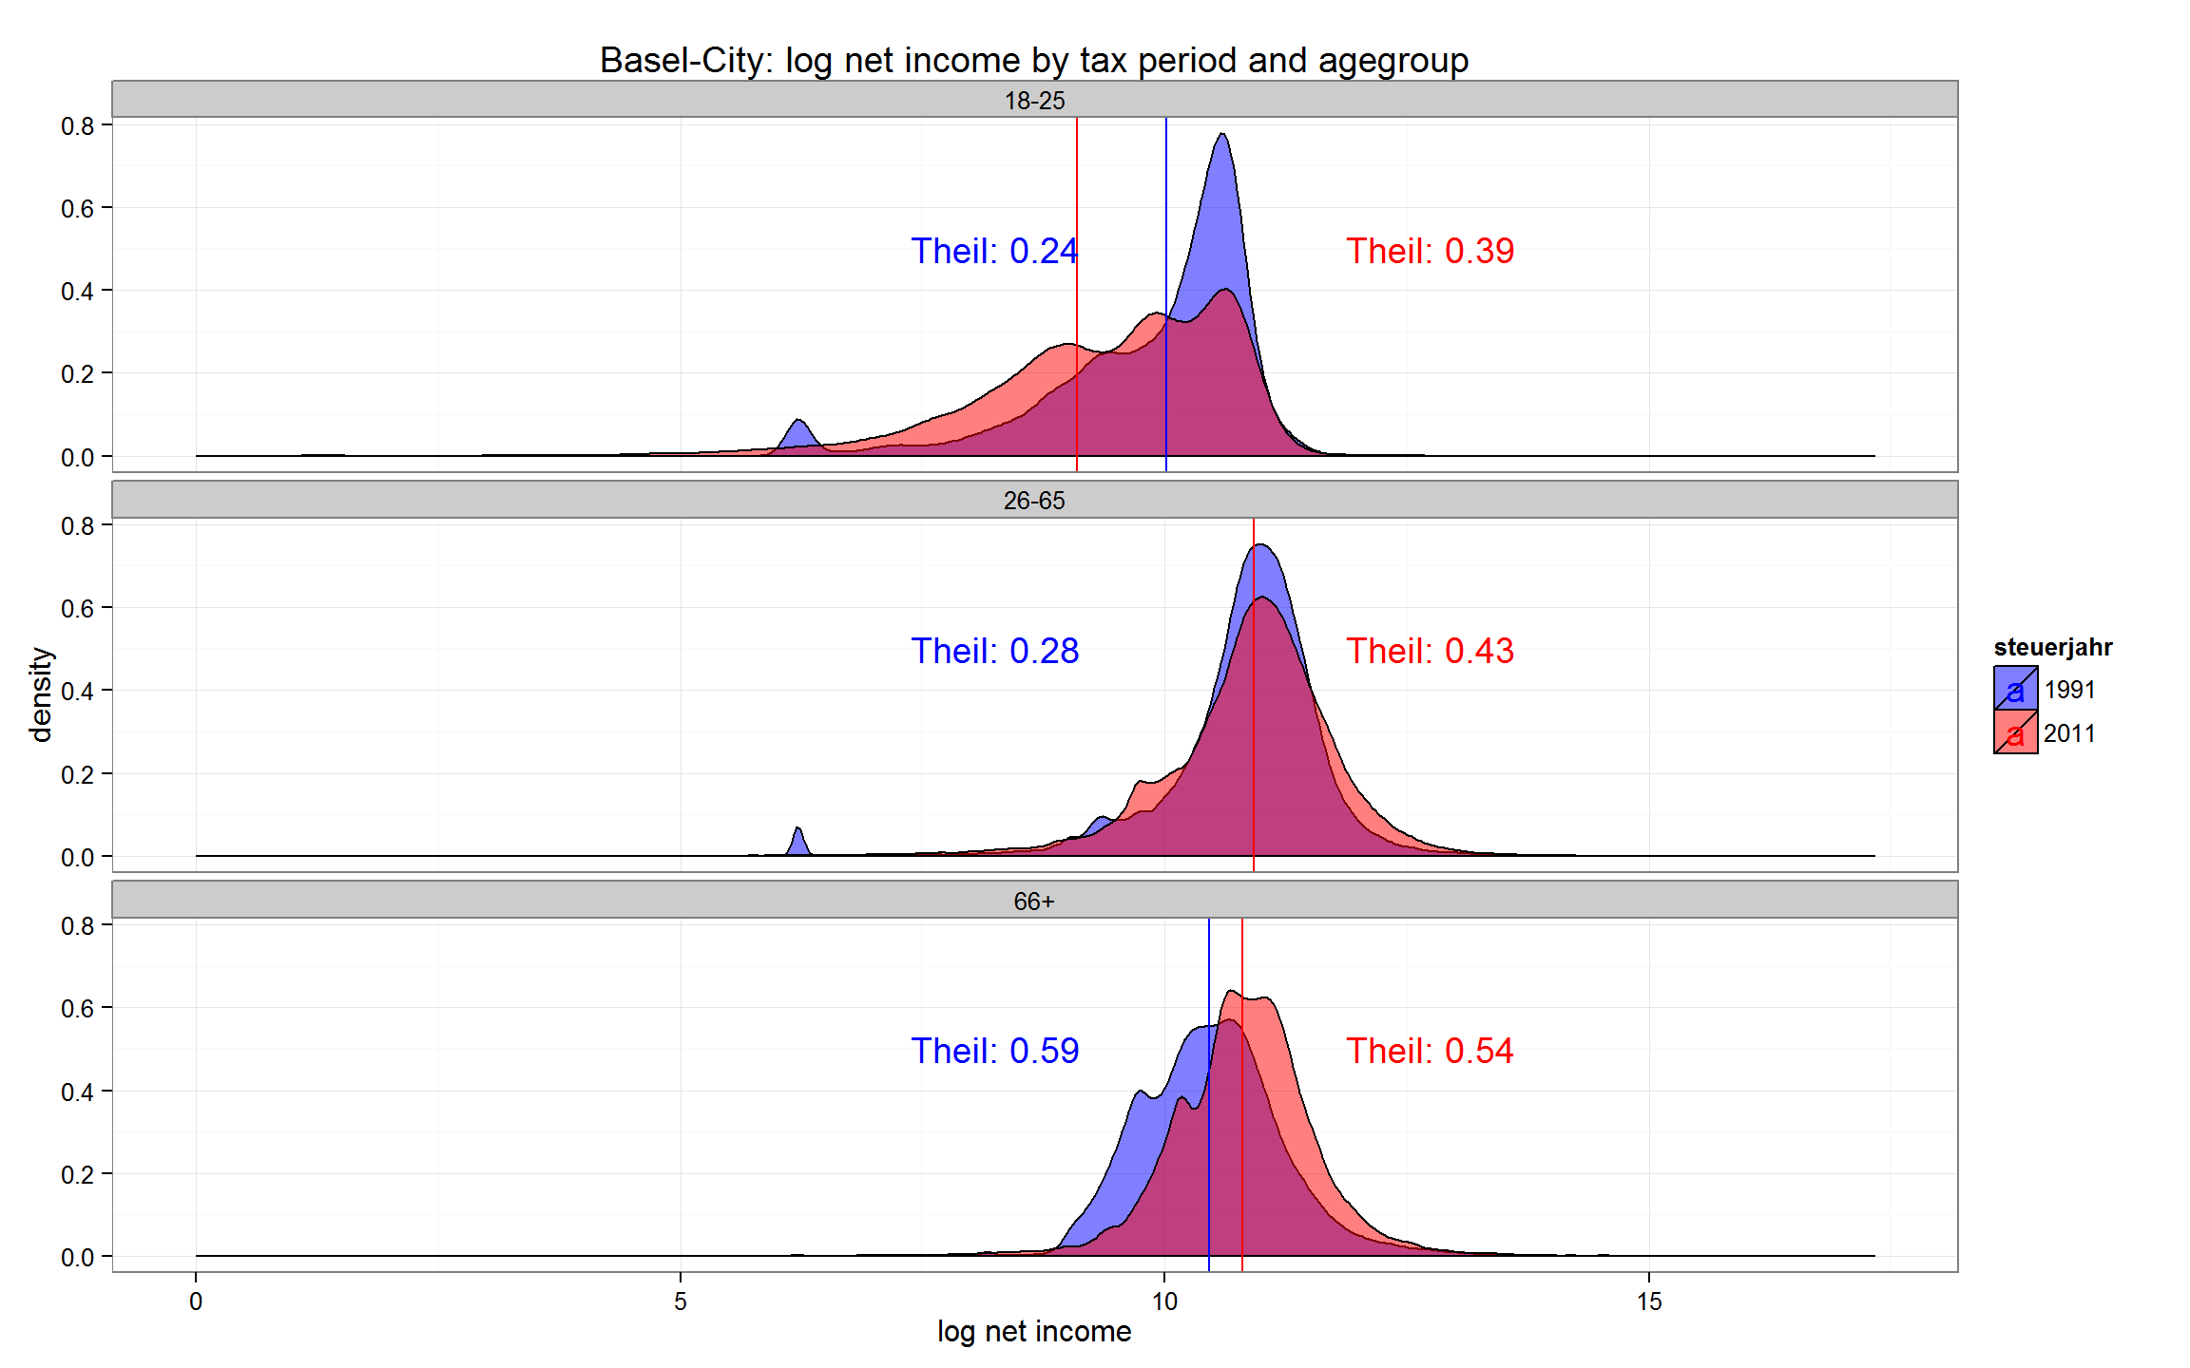
Results
Income distribution and inequality by age group

Slide 19
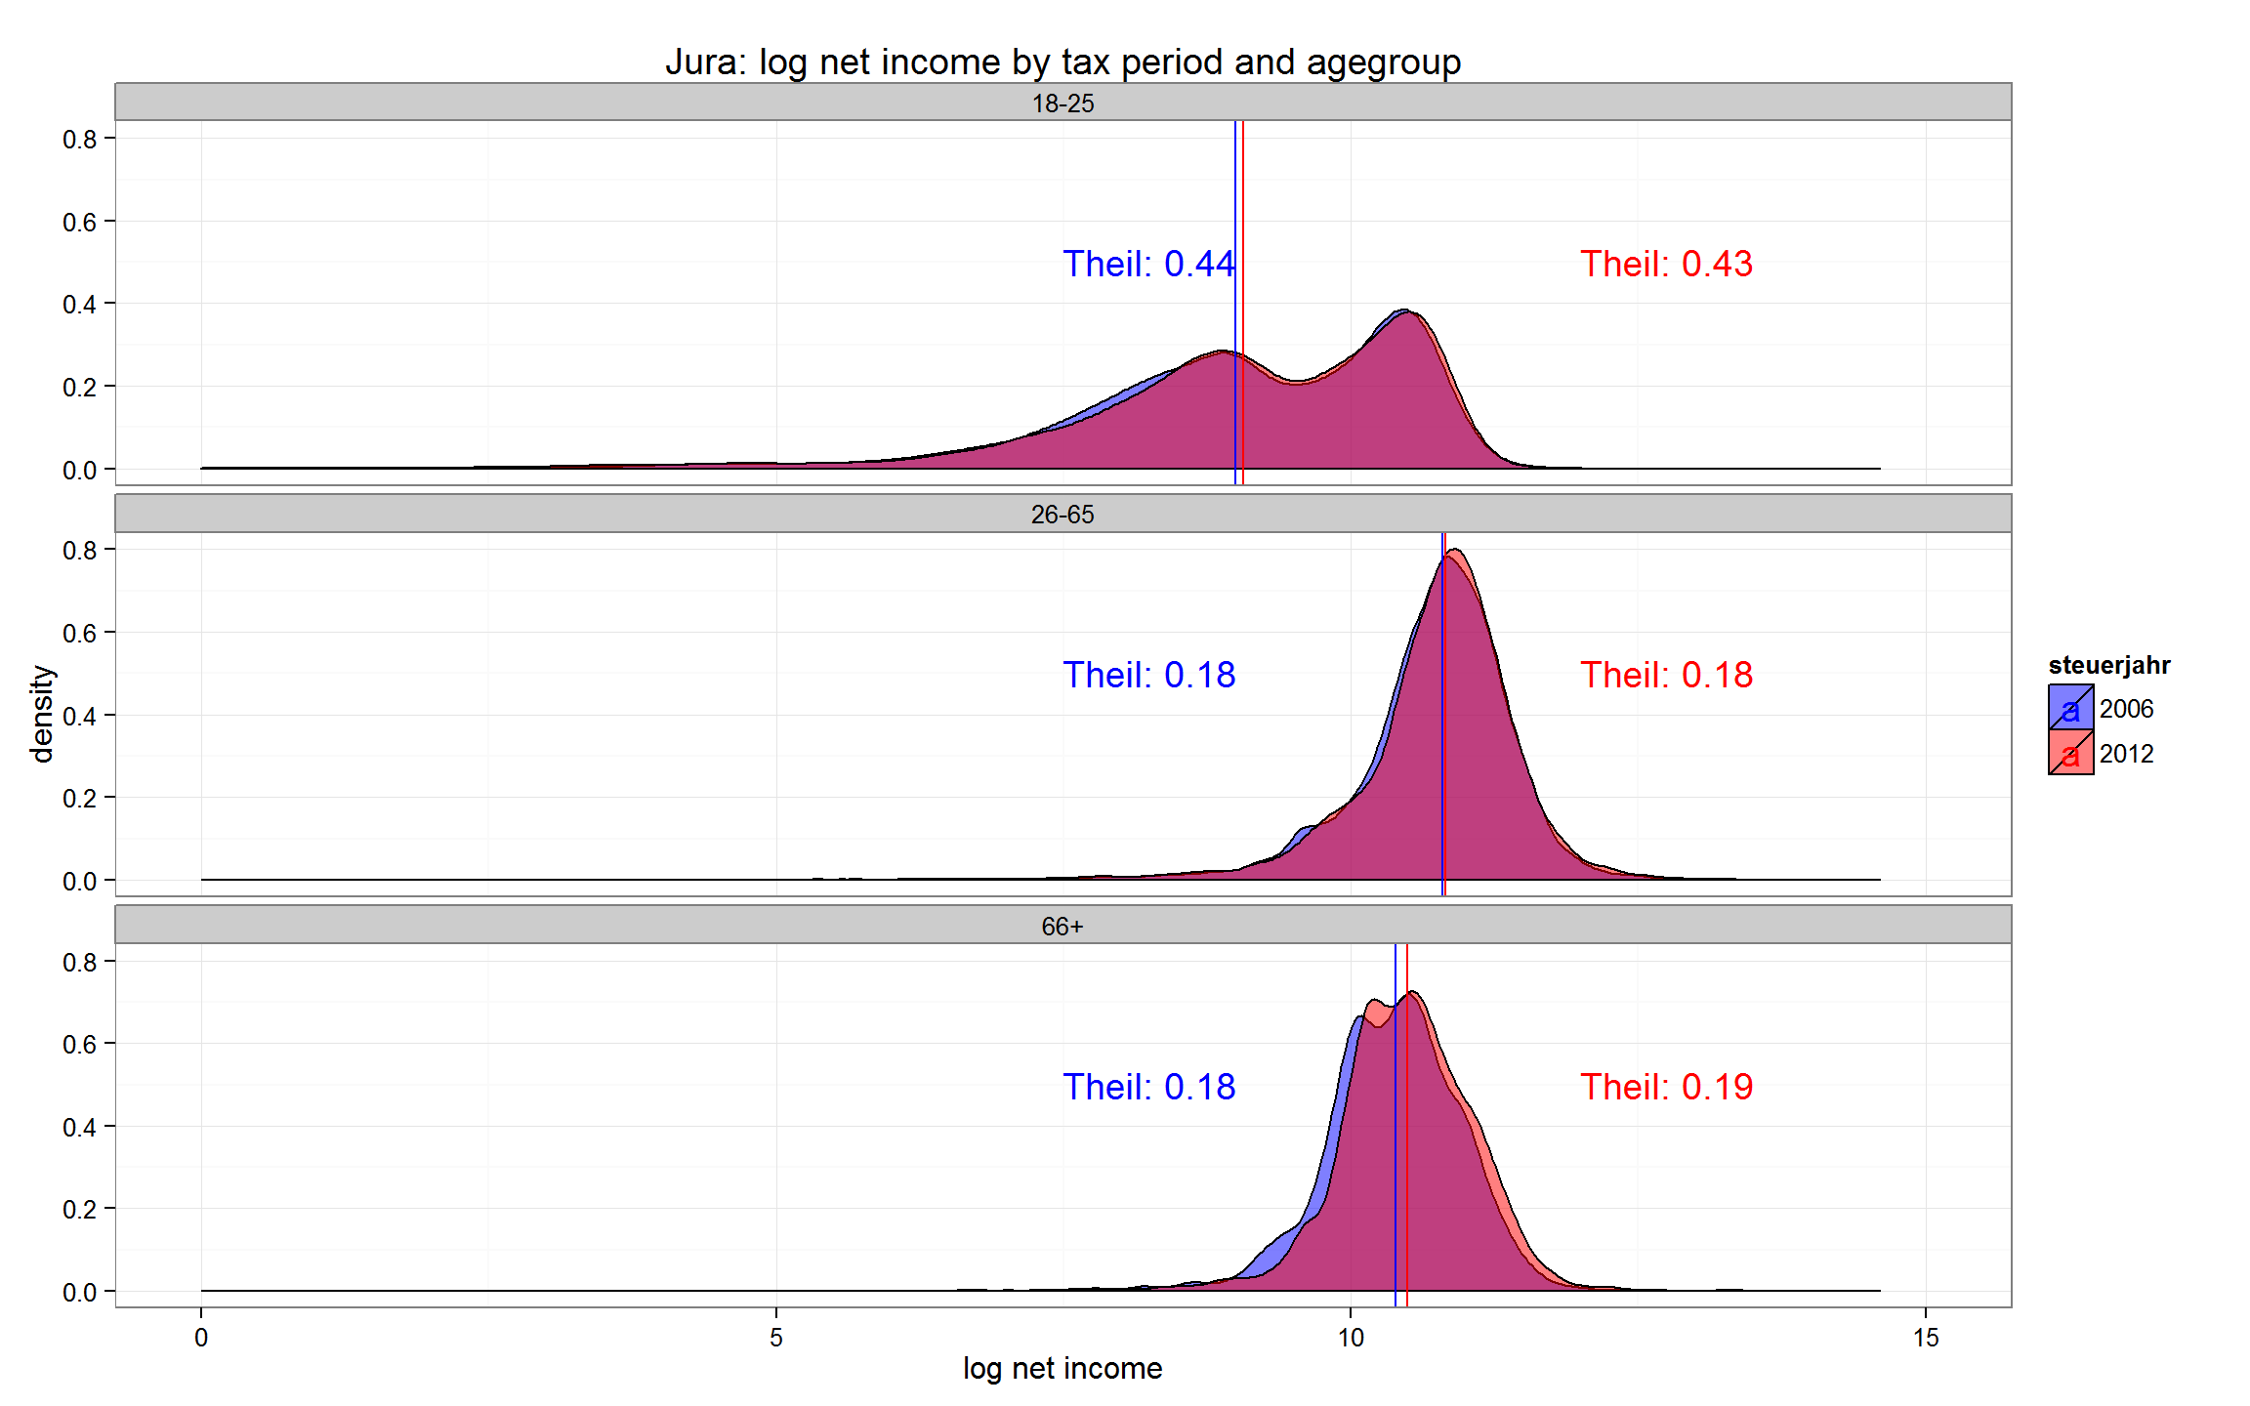
Results
Income distribution and inequality by age group

Slide 20
Interim Conclusion
Median incomes rose for retired people
BS: Median incomes rose for married
BS: Inequality rose especially within <66y
BS:18-25 year old became more diverse
BS: single dads became bimodal
Notes:
20

Slide 21
Hypotheses
Ageing of the population leads to a conflict between generations (Kaufmann 2005)
→ Indeed, inequality rose for working people and decreased for retired while
→ median incomes rose for retired people only
→ Overall inequality is strongly affected (52%/61%) by inequality within workforce (25-65). Trend is rising.
→ Ageing of society is rather associated with more equality
Rise in inequality in the US due to more people living alone (Daly/Valetta (2006)
→ People indeed live less and less in married households
→ Contribution of within single inequality and importance of between component to overall inequality did rise
Basel: Inequality is rather high for married people with kids, so an increase in single households would not directly increase inequality
Notes:
21

Slide 22
Interim Conclusion
Age groups
Overall inequality is strongly affected (52%/61%) by inequality within workforce (25-65). Trend is rising.
Contribution of within retired (65+) inequality to overall inequality declined (-7.7)
Ageing of society is rather associated with more equality
Household types
People indeed live less and less in married households
Contribution of within single inequality and importance of between component to overall inequality did rise
More inequality with more single households?

